Slide 1

2021-2022 Application
[Your name, field]

Slide 2
IMPORTANT: PLEASE READ BEFORE APPLYING.
Welcome to the Adobe Creative Residency 2021-22 application! We're excited to review your materials. We have strict qualification requirements--if you do not meet these criteria below, your application will not be considered.
1. You must live full-time in the US and be committed to building your local and national creative communities.
2. You must be able to write and fluently speak in English.
3. You must have legal working status in the US.
4. You must be willing to incorporate Adobe software into your daily, professional creative workflow.
5. You must be willing and able to commit to working solely as an Adobe Creative Resident during the duration of the program year (May 2021 through April 2022).
6. You must be in the early stages of your creative career ( approximately 1-5 years of work experience in your creative field).

Slide 3
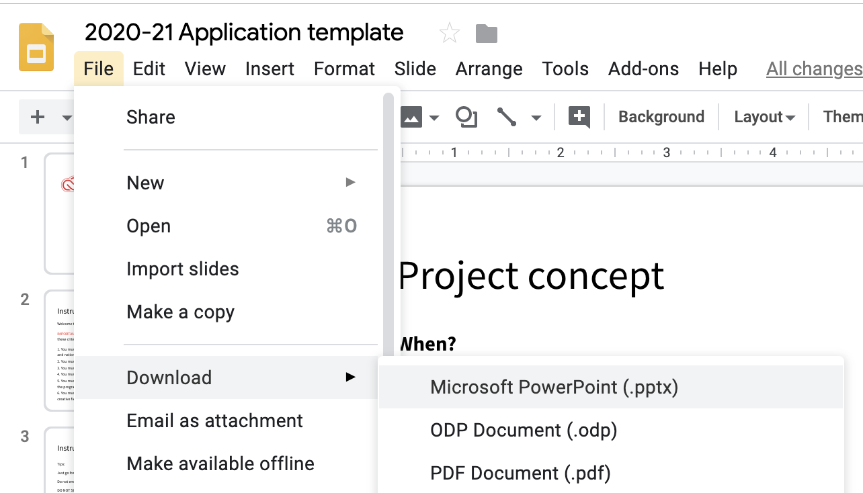
Instructions
DO NO REQUEST ACCESS TO THIS TEMPLATE. Use this deck as a guide for your application. You are welcome to use Adobe InDesign, Illustrator, Keynote, or any program to build your proposal, but you must upload it as a PDF into your online application. You can upload your proposal to the applications when it opens. Emailed application materials will not be considered.
If you want to download as a PPT to customize:

Slide 4
Instructions for video applicants
If you are a video creator:
Create a video that covers the topics on slides 8-17. Include the link to your private YouTube or Vimeo video submission in your slides, and create written content for slides 18-20.
Due to the large number of applicants, we can only view 5 minutes of video per application, so we suggest you not exceed that length so that all of your content can be reviewed.
Visit our site for a past Resident example of a video submission.

Slide 5
Application checklist
Run through this checklist before and after you build your deck to make sure you’re crafting your best application.
1. Take your time and think your project through. While your project may change and evolve during the residency, we want to see that you can flesh out an idea, make a plan, and execute on a project you’re passionate about.
2. Make this proposal visually interesting. Including visuals makes it easier for us to identify your style, strengths, and visual communication skills. If you use images in this deck from other artists, please make sure they’re credited.
3. Highlight your individual strengths. Why are you the right person for this project? When developing this application, think about what makes you unique and how you challenge the status quo within the creative industry.

Slide 6
Application checklist
4. Think about how you can change creatives’ perspectives. When developing your project idea, think about how you’ll inspire creatives in your field and help them grow—in terms of process, technique, audience, or knowledge. The point of the Adobe Creative Residency program isn’t only to help you grow as a creative but also to help others grow as well.
5. Consider how your project will appeal to people outside of your field. Make sure your project has wide enough appeal that people that aren’t creative professionals can understand your work.
6. Be sure you’re introducing yourself well. It’s important to remember that, while you might be aware of your skill set and ambitions, the person reviewing your project doesn’t know anything about you. Are you thoroughly outlining every detail in your project? Are you providing enough insight on how to bring your proposed ideas to life? Make sure we get the vibe that you’re a visual creative.

Slide 7
Application checklist
7. Show or explain how your project will challenge you. You want to create a proposal that you have the capacity to fulfill, but it should also be ambitious. Make sure it’s a stretch goal that pushes you outside your comfort zone while building on your existing know-how and skill set. Dream big, don’t propose something safely within your comfort zone, but do make sure your project plays to your strengths and builds off of your existing skill set.
8. Develop an elevator pitch. Have a solid 30-second explanation of what your project is about. We want to see that you have the ability to articulate projects in clear, understandable, and relatable language.
9. Articulate how the residency will be the start of the next stage in your career. This program is for people who are ready to invest wholeheartedly in pushing their creative career to the next level.

Slide 8
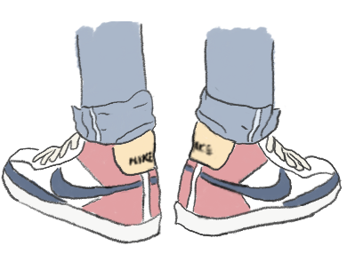
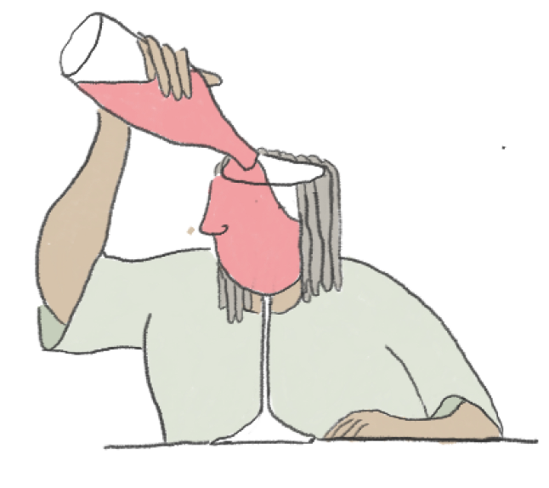
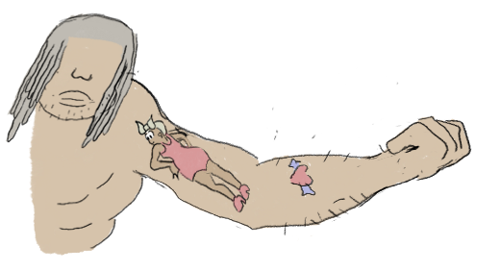
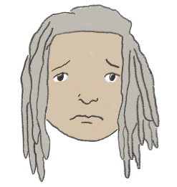
2 years ago, our hero was defeated, getting denied from the 2019 Adobe Creative Residency.
He took it hard, but knew the opportunity would come again.
So he trained. He became wiser, and more mature.
And now, he comes back ready to apply. Will he succeed?
Juweek Adolphe
Illustrator/Creative Coder

Slide 9
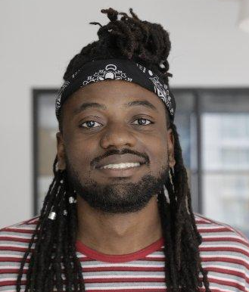
*This is how I look like

Slide 10
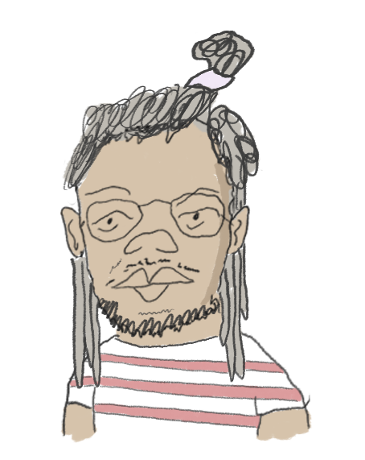
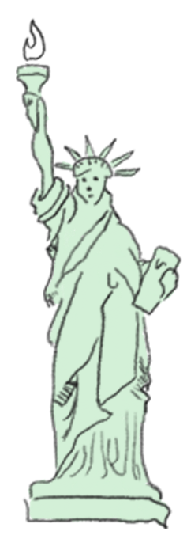
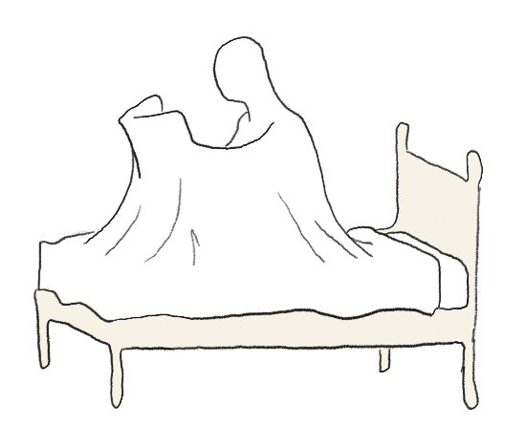
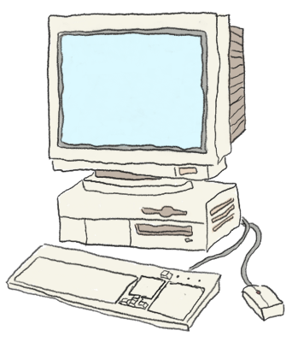
Today, we take a look at our hero, Juweek, and his Adobe application.
Will he get it? I don’t think so, but let’s see.
....uh, thanks..
Hi, I’m Juweek. I’m the hero.
That narrator is kind of a jerk.
The Introduction
I’m 26, and I live in Brooklyn, NY. I’m the son of two Haitian immigrants, and a fan of basketball and football.
Most of all, though, I’m a huge comic book nerd. I have been since I was a kid.
I’m a sucker for a good story, and in my free time, I like to draw and animate my own little stories..
The Personality
Professionally, I’m a “creative coder”. It’s hard to explain, but basically I make websites, and they tend to veer on the more artistic side.
Most companies don’t have a need for “creative coders” who like to draw. However, there was one place where my skills were a perfect fit, a place where multidisciplinary work was encouraged:
The Art
JOURNALISM!
Notes:
Introduction
3-5 sentences about you, including name, location, creative field, defining attributes, 1-2 of your relevant hobbies / passions

Slide 11
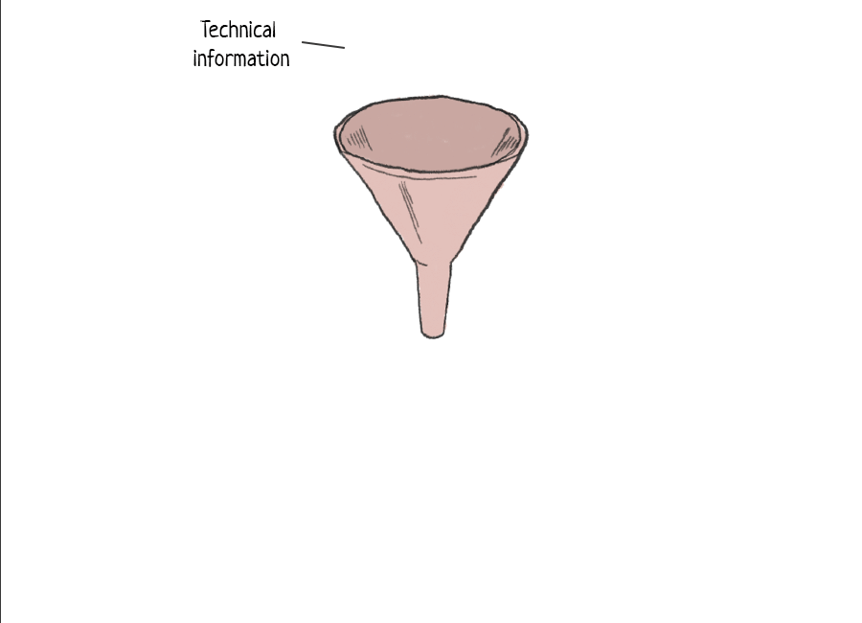
The Artist statement
Juweek is a journalist who processes technical information and channels it into visual and interactive stories. He often uses humor to humanize the content and make it less intimidating to companies and readers alike.
At the core of his essence, Juweek is an educator, and he cares a lot about making information accessible to all.
Notes:
Artist statement
3 sentences about who you are as an artist, your value to your future clients, and what drives your creative vision.

Slide 12
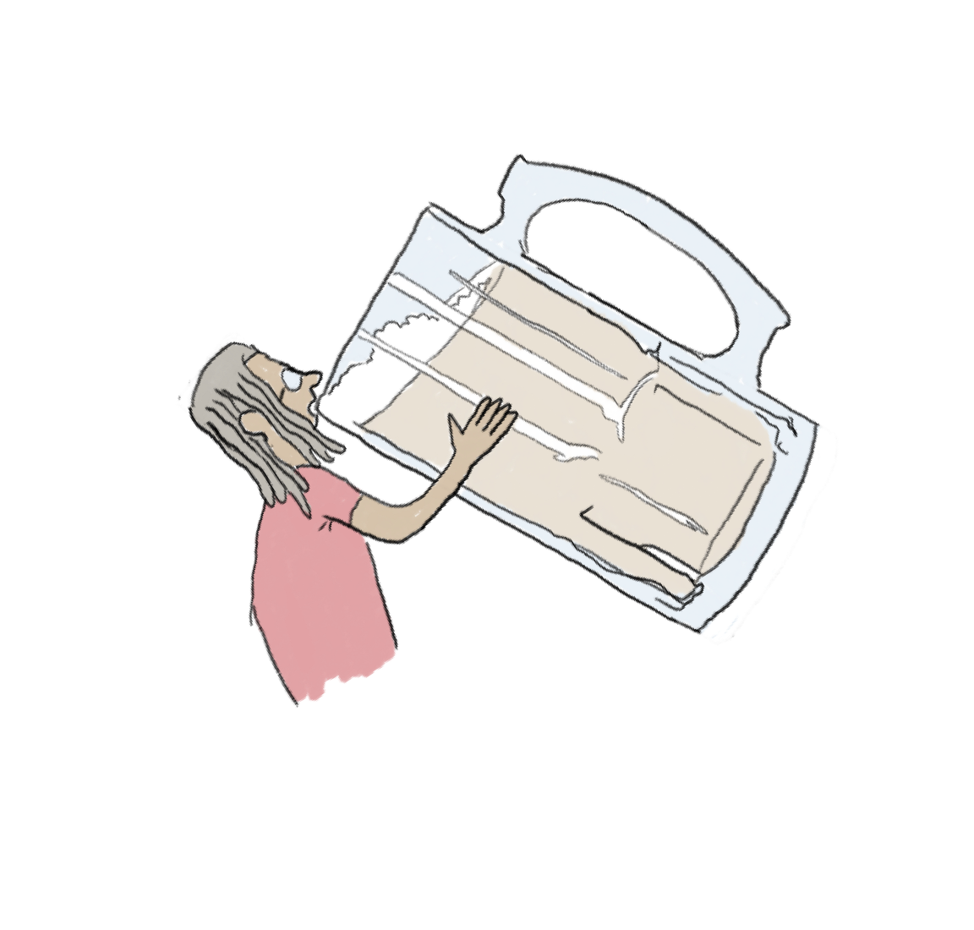
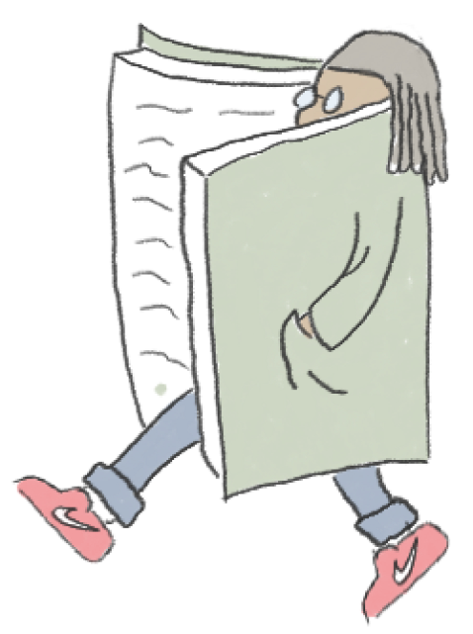
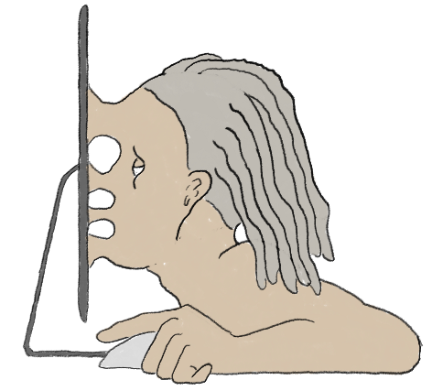

Episode 1:
The College Years
My background is all over the place. It starts with college, where I studied Computer Science and drunk a moderate amount of beer.
Some would call me ‘booksmart’. I was a part of two research labs, and helped start a third one (I got to work with NASA on that one).
I graduation college in 2016 with a love of learning, and an obsession with everything STEM-related.
2016
Episode II:
Odd Jobs Era
I moved to New York to start my career, but ended up taking a lot of side gigs that I hated.
*Shudder* I don’t like talking about this time period that much.
Professionally, I was aimless. Freelance didn’t work for me, and neither did the corporate lifestyle. These years showed me the type of work I did not want to do.
2017 - 2018
Episode III:
The Guardian
Eventually, I stumbled into a job at the Guardian, and I fell in love. As a visual journalist, I used my code and designs to create special web pages that told stories.
Journalism was a good fit because my love of art and code and storytelling worked well together. I was promoted to Editor, and took increasingly large roles in projects like COVID and the election.
I left the Guardian after the 2020 elections, but I left with a thought: a lot of stories required visual graphics, and I felt like there was room to explore what those graphics would look like.
2018 - 2020
Notes:
Introduction
3-5 sentences about you, including name, location, creative field, defining attributes, 1-2 of your relevant hobbies / passions

Slide 13
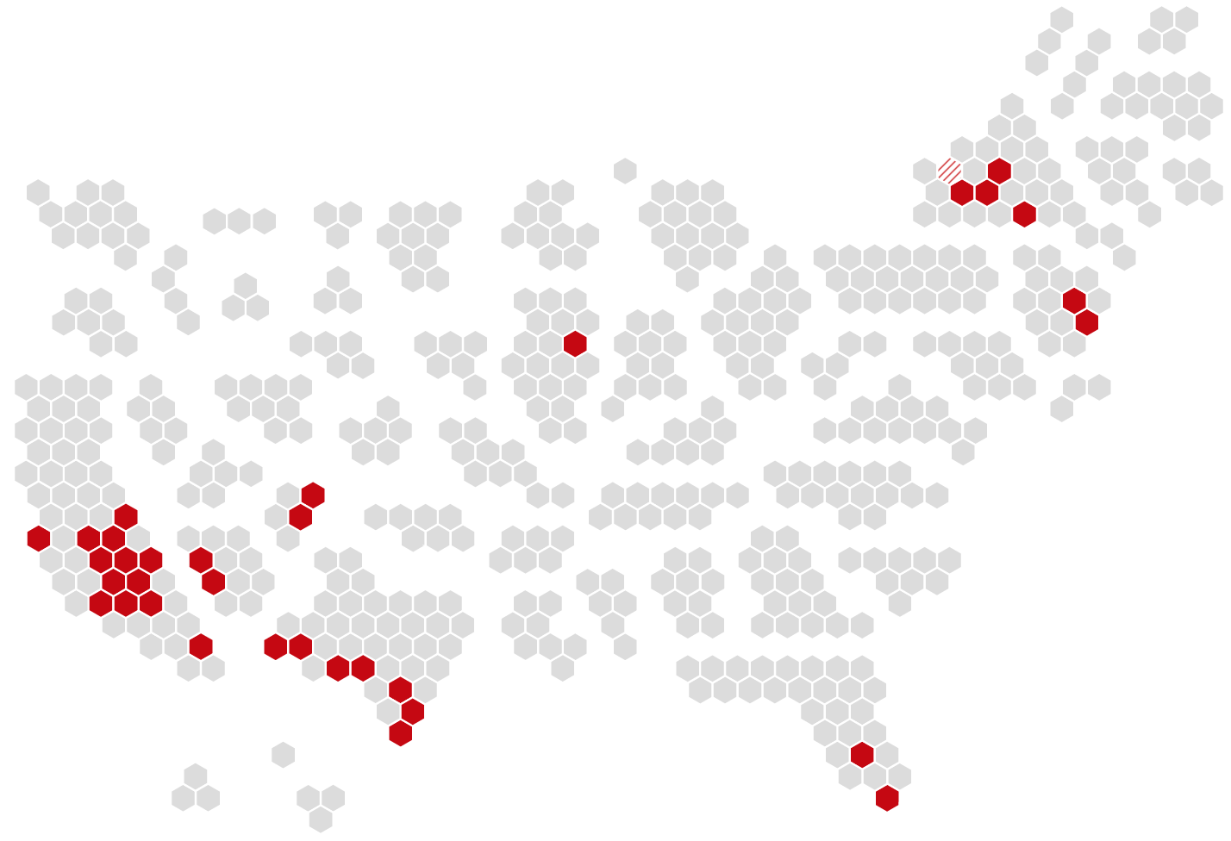
Congressional Map
I created a map of the members of the 2018 Congress. I cross-referenced it with a map of all congressional districts on the United States, and what resulted was an interactive map where users could select identities and see the map filter itself.
This project was a perfect example of how design and code allowed for an educational experience that was different from just the written text, and provided more context than what words, graphs, or images could have in isolation.
Notes:
Artist statement
3 sentences about who you are as an artist, your value to your future clients, and what drives your creative vision.

Slide 14
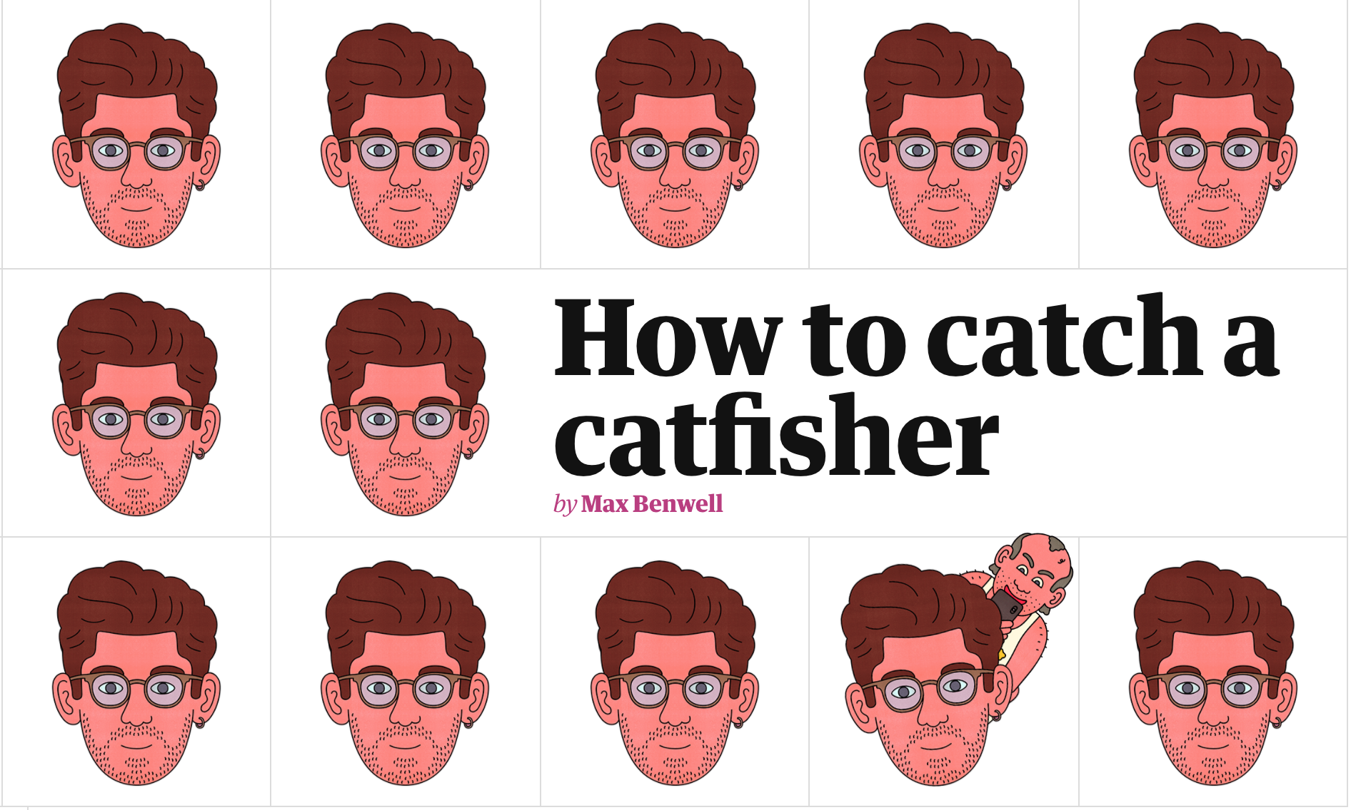
How to catch a catfisher?
How to catch a catfisher was the first iteration of me mixing illustrations with code. Working with an illustrator, a writer, and a fellow web designer, we crafted unique storytelling experience, with elements of the story being coded and animated at certain points to fully immerse the reader.
Notes:
Artist statement
3 sentences about who you are as an artist, your value to your future clients, and what drives your creative vision.

Slide 15
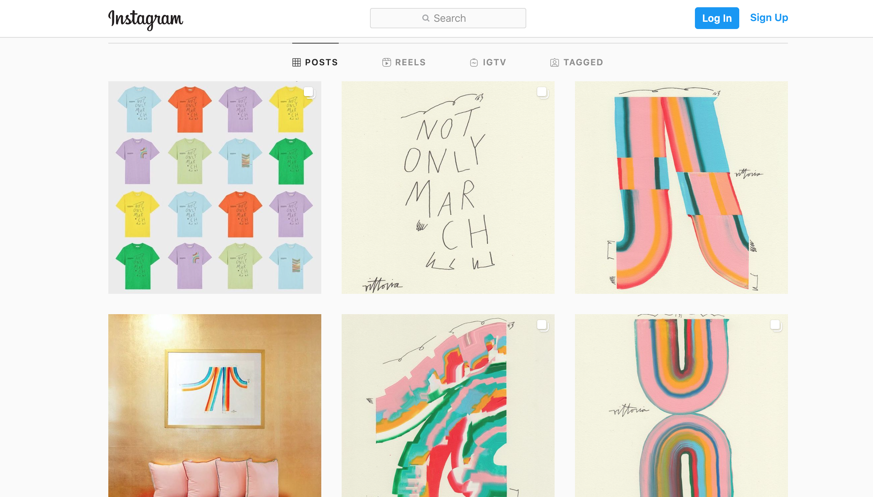
Instagram page
The best way to get a feel of my work is to view it on Instagram. My IG focuses on my animations, and each post contains a narrative captured in a moving picture.
Notes:
Artist statement
3 sentences about who you are as an artist, your value to your future clients, and what drives your creative vision.

Slide 16
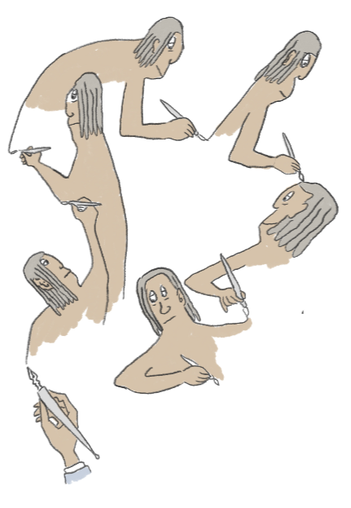
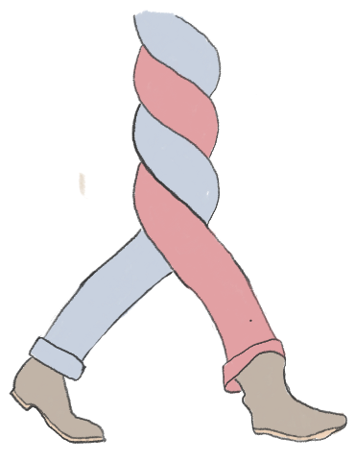
Where I want to be
*Note about how you have a goal of connecting with multi discipline creatives, and how the residency will better allow you to network and promote that community.
I want to create stories full-time. Most of my work so far has been in journalism, but I want my future work to involve narratives and characters, and I want them to live in tv shows, blogs, comic strips, books, theme parks, and more. Having eyes on me because of the residency increases that likelihood.
I want to continue to be interdisciplinary. More and more companies are looking for specialization, so I want to connect with the interdisciplinary community and network in that space. Having a year to experiment allows me to work out the kinks.
Notes:
Introduction
3-5 sentences about you, including name, location, creative field, defining attributes, 1-2 of your relevant hobbies / passions

Slide 17
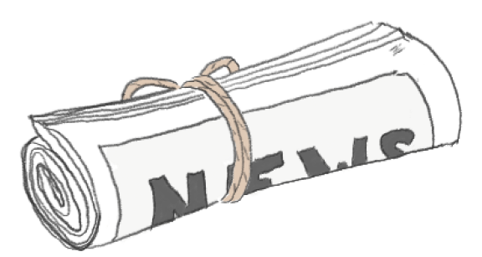
Other people who’ve been able to achieve my dream
Mona Chalabi
Homestuck
Nicky Case
Comic journalism
The company Brilliant
Kurzegast/Infographics Show
Notes:
Career goals
Where are you and your work now?
If you’re pivoting into a new industry, style, workflow, etc., explain
Intended audience
Ideal clients and why
How Adobe fits into your journey from where you are to where you’re headed

Slide 18
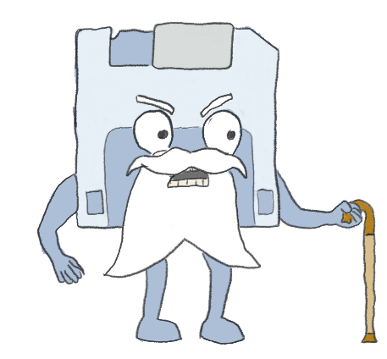
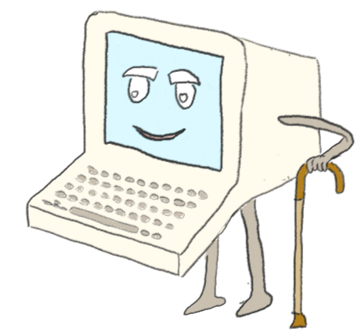
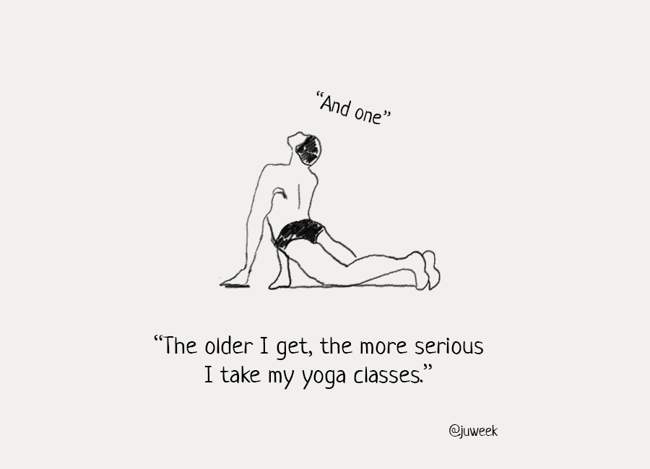
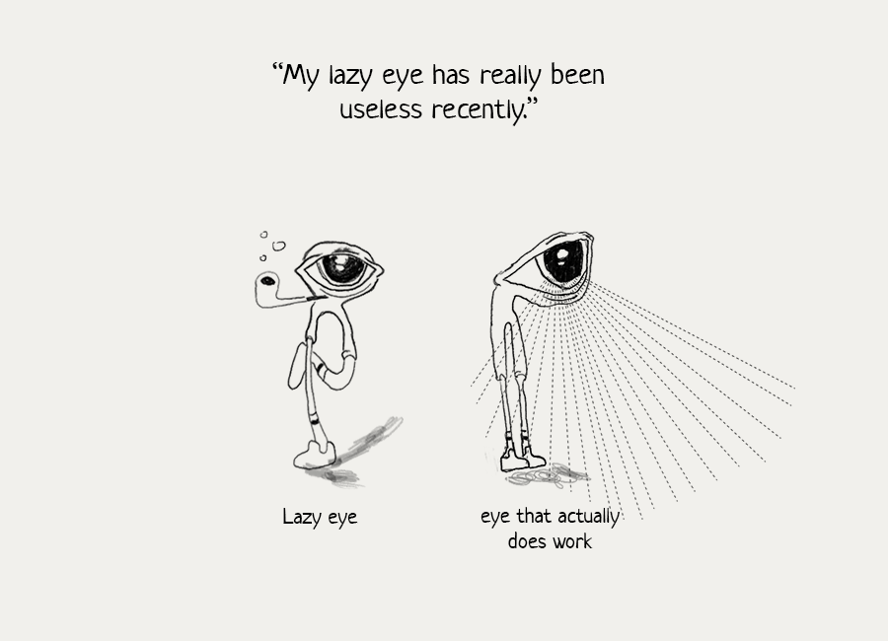
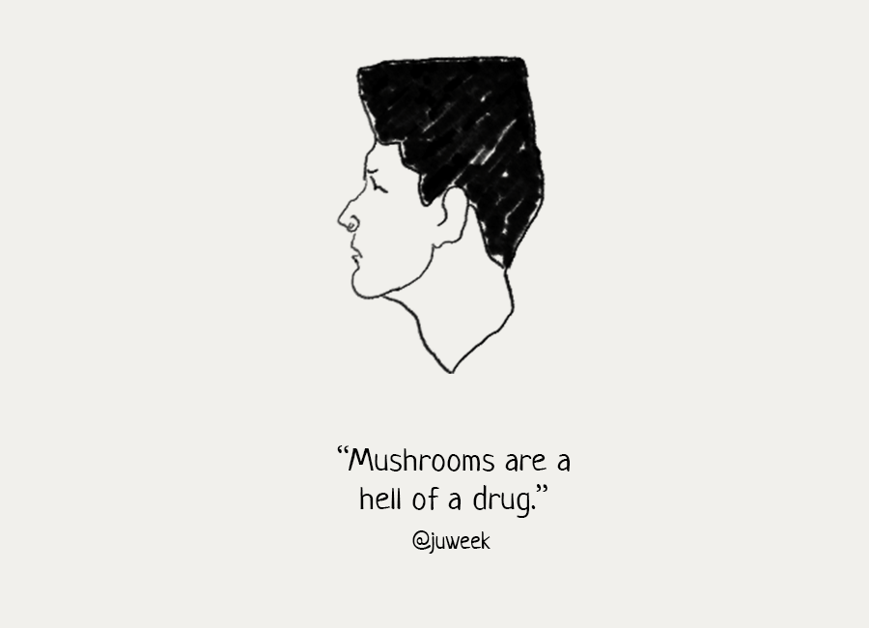
Technotopia

Slide 19
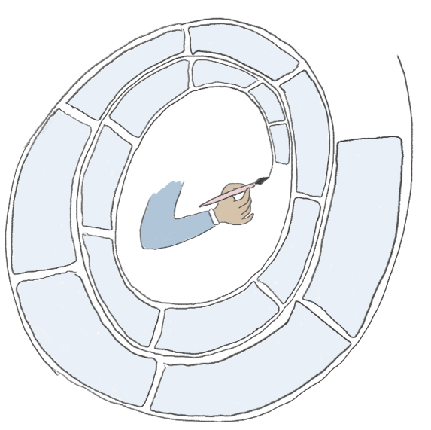
Meet Technotopia
Finally, I thought our hero would never stop talking.
But now comes the most important part: the proposal idea....
Dude, what’s your problem?
My idea is to create a comic strip about technology. It’d be called Technotopia, and would focus on a town where technology lives.
Each comic will follow a town resident and their interactions. Because the town is full of technology, I want the content to be educational as well.
Comics are a weird way to teach, but they shouldn’t be. The world is changing quickly and becoming more complicated. We should embrace any technique that may bridge knowledge gaps, especially one that offers tools like abstraction and animation.
Ultimately, the goal is to create a webcomic that serves as an accessible introduction to technology concepts,
Notes:
What?
Project: Succinct project concept pitch composed of 1 main project (can be broken down into parts).
Keep in mind that about half of your time as a Resident will be focused on your personal project, and the other half on Adobe-related projects (giving talks, press and panel interviews, live streaming your process, giving workshops, mentoring students, etc). If your project can dovetail these two, wonderful, please explain how you envision that.
Example: Anna Daviscourt’s Scaredy Cat project proposal
https://www.behance.net/gallery/62895799/Scaredy-Cat-Pt-2
Format / medium
Deliverables

Slide 20
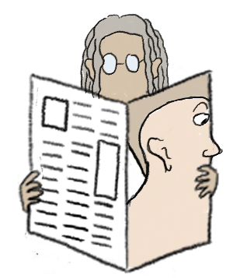
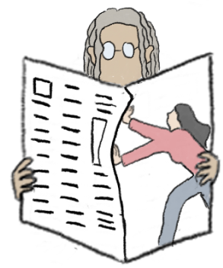
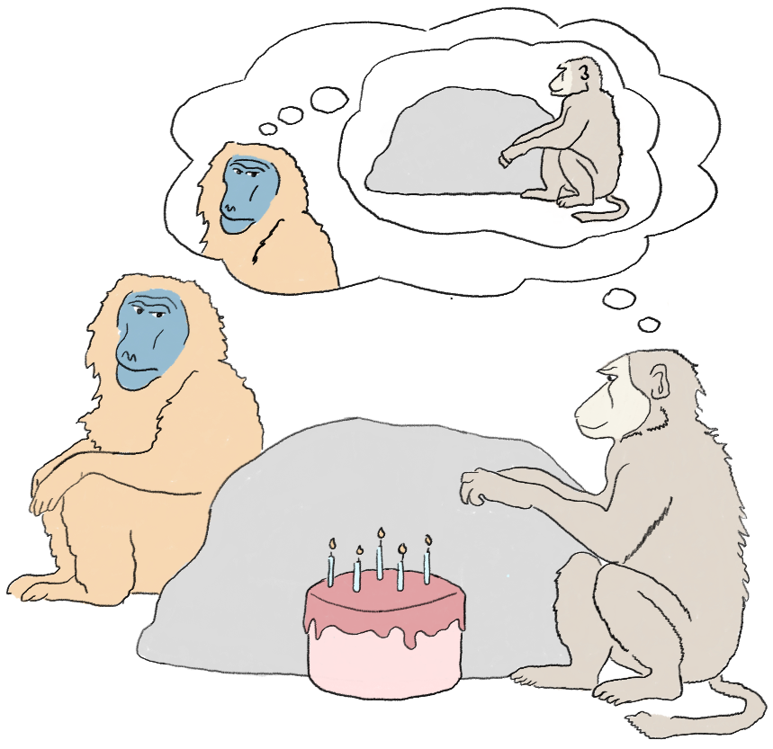
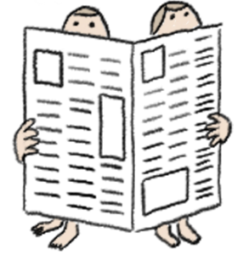

What is active reading?
Finally, for the special few stories, I take the narrative to the web and code simple interactions, like button clicks, to bring the story even more to life.
Finally, for the special few stories, I take the narrative to the web and code simple interactions, like button clicks, to bring the story even more to life.
Finally, for the special few stories, I take the narrative to the web and code simple interactions, like button clicks, to bring the story even more to life.
Finally, for the special few stories, I take the narrative to the web and code simple interactions, like button clicks, to bring the story even more to life.
Fig:1.1. An example an a a visual that uses ‘active reading.’ If you had to explain what was going on in this photo, what would you say?

Slide 21
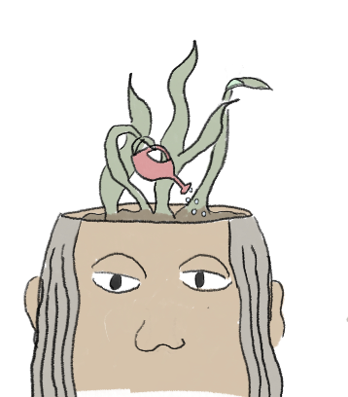
What are your deliverables?
Much like you see in this application, I will create comic strips about Technotopia. Most will be animated gifs, shared on Instagram, and hosted on my eventual site.
That narrator is kind of a jerk.
(52) Animated comics
What will distinguish my comic series will be the subject matter, and the fact that it will be animated.
Some topics are impossible to cover fully in a comic strip. I will make longer issues that include more text, and potentially some code.
The inclusion of code will allow my projects to dream bigger. Who knows what I will end up making?
I will share process shots, and excerpt slideshows on Instagram to promote the essays, but they will live on my own site, as will all of the animated comics.
(6) Longer essays
While the actual content is important, so is where it is housed. I will create a website that will host all the gifs and essays I create.
This residency is only a stepping stone, and it’s important for me to have a strong brand at the end. I will spend to figure out how to leverage the eyes I’ll have on me.
I actually already started:
(1) Website/ brand
sketch-notes.co
Notes:
Introduction
3-5 sentences about you, including name, location, creative field, defining attributes, 1-2 of your relevant hobbies / passions

Slide 22
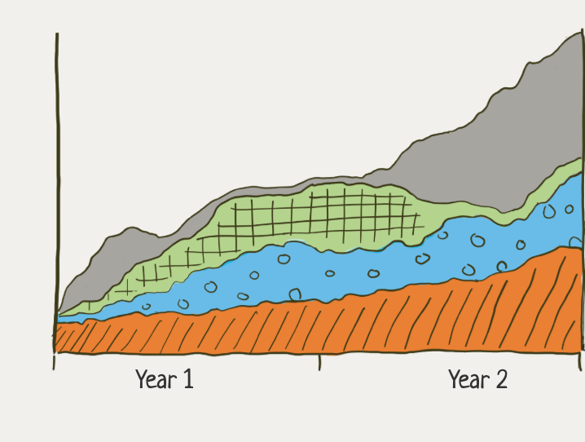
My Process
So, at last, the hero’s art is revealed. Comic panels that aim to engage the reader. Not a terrible idea, but how do they get maid?
Like most everything I make, I start with a topic or idea. I learn as much as I can about it, and start to pick out the most important points or two to flesh out a story.
With this basic outline, I get to work on the comic panels. I draw and color them in, then animate a few panels here and there to really add life to the story.
Finally, for the special few stories, I take the narrative to the web and code simple interactions, like button clicks, to bring the story even more to life.

Slide 23
Today, we take a look at our hero, Juweek, and his Adobe application.
Will he get it? I don’t think so, but let’s see.
....uh, thanks.
Hi, I’m Juweek. I’m the hero.
The Timeline (deliverable)
May - July
Aug - Oct
Nov - Jan
Feb - May
Weekly comics
Publish and promote
Ideation
Features
Website

Slide 24
Today, we take a look at our hero, Juweek, and his Adobe application.
Will he get it? I don’t think so, but let’s see.
....uh, thanks.
Hi, I’m Juweek. I’m the hero.
The Timeline (deliverable)

Slide 25
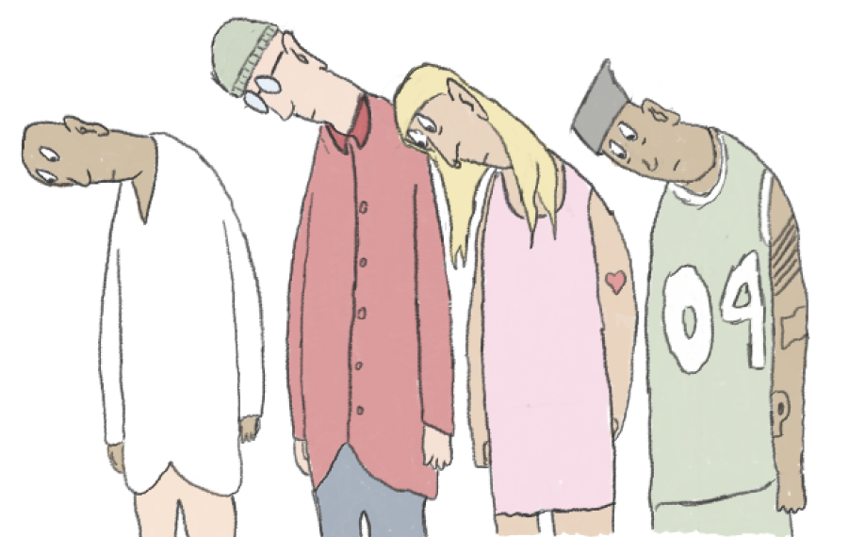
Sharing with the community
I will go to places like CreativeMornings, Interview place 2, etc and conduct interviews to promote my work, the Adobe brand, and the philosophy of multidisciplinary work.
I will host workshops on creatives can include other disciplines into their practice, whether that includes data viz, animation, or even very simple code.
Network with the community. Going to interdisciplinary conferences, introducing my project to fellow enthusiasts.
Monthly, I will record a blog post. Tyler Babin was good at this, as was Anna Daviscourt

Slide 26
Today, we take a look at our hero, Juweek, and his Adobe application.
Will he get it? I don’t think so, but let’s see.
....uh, thanks.
Hi, I’m Juweek. I’m the hero.
The Timeline (social)
May - July
Aug - Oct
Nov - Jan
Feb - May
Weekly comics
Publish and promote
Ideation
Features
Website

Slide 27
Project concept
Example:
Main Project: Pride Day shoot BTS video
Model fee | $ XXX
Props and backdrop | $ XXX
Lighting rental | $ XXX
Venue rental | $ XXX
Makeup / hair | $ XXX
Total | $ XXXXX
How?
Project budget breakdown (not including hardware or travel)
We’re looking at your ability to do some basic research on costs based on your estimated project needs. Just get us in the right range of how much your project might cost.
We do not pay for collaborator fees, monthly studio rent, wifi, or utilities.
Budget should be denoted in your country’s currency: $, Can$, £, €, or ￥.

Slide 28
Project concept
Creator: Juweek Adolphe
Collaborators: Adobe, academics, journalists
Audience: Technologists, educators, children, companies looking to sponsor tech-focused content
Mentor: My ideal mentor would be someone who has created a webcomic of their own. A key part in the success of The Computers will be the quality of the stories it tells, so I want to look for mentors who have experience telling stories.
Animation is still a new skill for me, so technically I’d love to have mentors who can teach me tricks that’d raise the quality of my animations.
Finally, I want a mentor who also stays interdisciplinary in their subject matter. A big way for me to learn is by discussion, and bouncing off ideas. Having a routine discussion on nothing but art and the process will actually unlock quite a lot of creativity from me. Swoozie?
Notes:
Mentor: What skills/abilities/attributes does your mentor need to have to help you develop your skills, creative business, project and goals? If you have examples of someone(s) who might fit the profile you’re looking for, include their social/website here. If you’re chosen to be a Resident, we’ll help you refine your search and contract the right person.
Tip: Identify what you really want to achieve, how you learn best, and what kind of mentoring relationship might work well for you. Consider past mentor relationships: What worked well? What could have gone better? How did you contribute to the success of that relationship?

Slide 29
Project summary
Who
You, collaborators/partners
Audience
What
Concept
How
Project specs, travel, total money needed
When
General timing of main and side projects
Where
Physical and/or digital spaces
Why / impact
Community involvement
Societal impact / context / timeliness

Slide 30
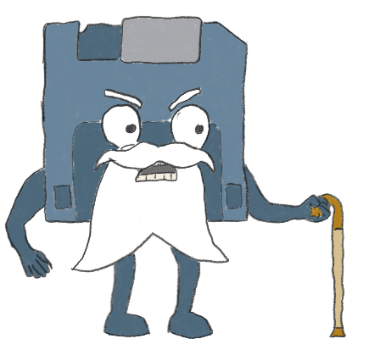
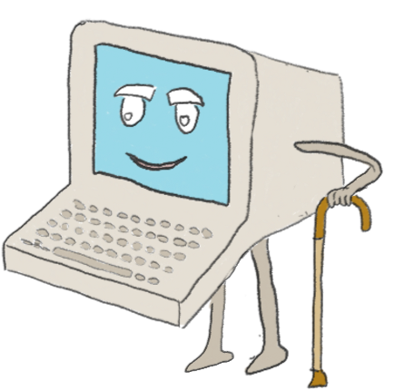
Comic will aim to explain things
“God, I hate that ‘Cloud.’ He has no respect for us storage folks of the past.”
He’s right! Have you ever wondered how Cloud stores so much information? It’s because he’s not storing it; he’s just retrieving it! What a fraud!
Notes:
What?
Project: Succinct project concept pitch composed of 1 main project (can be broken down into parts).
Keep in mind that about half of your time as a Resident will be focused on your personal project, and the other half on Adobe-related projects (giving talks, press and panel interviews, live streaming your process, giving workshops, mentoring students, etc). If your project can dovetail these two, wonderful, please explain how you envision that.
Example: Anna Daviscourt’s Scaredy Cat project proposal
https://www.behance.net/gallery/62895799/Scaredy-Cat-Pt-2
Format / medium
Deliverables

Slide 31
Many comics will be animated and/or interactive
Potential reader
Notes:
What?
Project: Succinct project concept pitch composed of 1 main project (can be broken down into parts).
Keep in mind that about half of your time as a Resident will be focused on your personal project, and the other half on Adobe-related projects (giving talks, press and panel interviews, live streaming your process, giving workshops, mentoring students, etc). If your project can dovetail these two, wonderful, please explain how you envision that.
Example: Anna Daviscourt’s Scaredy Cat project proposal
https://www.behance.net/gallery/62895799/Scaredy-Cat-Pt-2
Format / medium
Deliverables

Slide 32
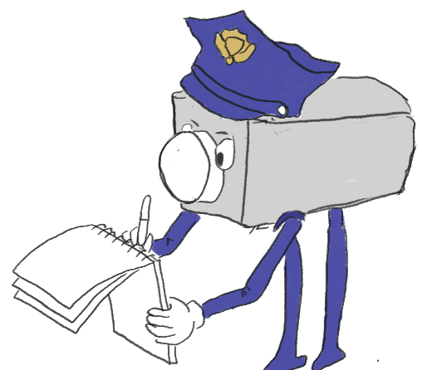
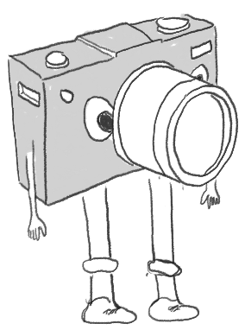
Comic will tell real, relevant stories
“Dad, I keep getting bullied at school because you getting people in trouble.”
Notes:
What?
Project: Succinct project concept pitch composed of 1 main project (can be broken down into parts).
Keep in mind that about half of your time as a Resident will be focused on your personal project, and the other half on Adobe-related projects (giving talks, press and panel interviews, live streaming your process, giving workshops, mentoring students, etc). If your project can dovetail these two, wonderful, please explain how you envision that.
Example: Anna Daviscourt’s Scaredy Cat project proposal
https://www.behance.net/gallery/62895799/Scaredy-Cat-Pt-2
Format / medium
Deliverables

Slide 33
Project concept
How (continued)?
Needed hardware. Hardware is not paid for by the program, except a laptop that would be loaned to you from Adobe IT. Corporate hardware sponsorships might be negotiated on a case-by-case basis.
Technical requirements. Special software/tools, etc. What will your creative process be from beginning to end? What digital or analog tools will you use? How will mobile apps be integrated into your workflow?
Skills you still need to acquire, desired resources, and/or other support to pull-off this project.

Slide 34
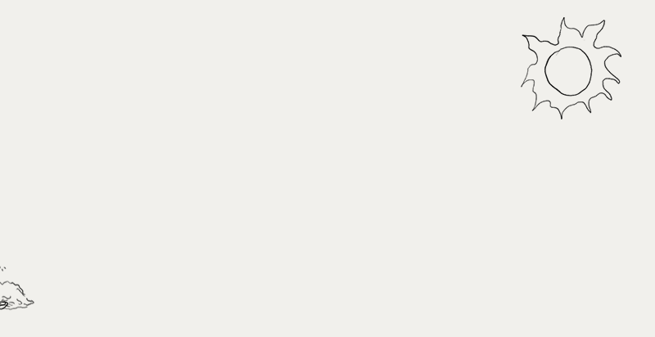
Where do I want to be?

Slide 35
Today, we take a look at our hero, Juweek, and his Adobe application.
Will he get it? I don’t think so, but let’s see.
....uh, thanks.
Hi, I’m Juweek. I’m the hero.
The Introduction
Absolutely!
I’m a firm believe of the concept of ‘active reading’: which is the idea of engaging with content in a way that builds brain synapses.
I believe in play, and with my coding skills, I’ll be able to implement ideas in creative ways
I also want to try my hand at articulating some of the complicated conversations happening around tech. I truly do believe that quite complicated ideas can be conveyed if visuals and interaction were encouraged to collaborate more regularly with written text.

Slide 36
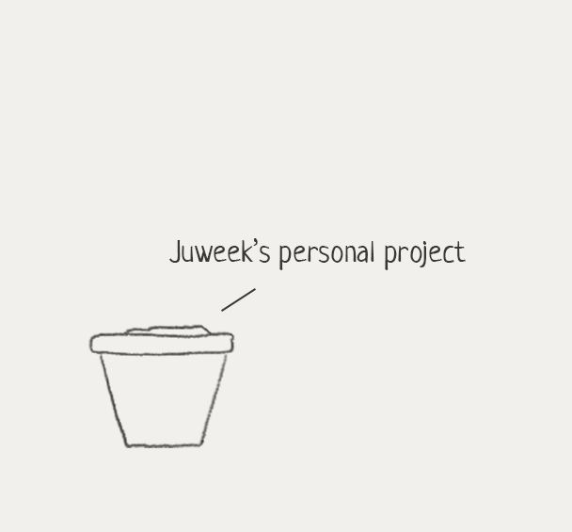
3) I will become independent by building something that grows
I don’t want to become just another content creator.
Rather than marketing myself, I want to have something separate from me that has a life of its own. It will become more manageable for me to curate, market, and even end it as needed. And, at the very least, it’ll be a complete project that I can add to my portfolio.
There are many ways a project can grow. With my skill set of code and illustration, I can:
Create a blog or newsletter
Write (or draw) a book
Create an animated show
Create a brand and sell merchandise
So much more
Notes:
Career goals
Where are you and your work now?
If you’re pivoting into a new industry, style, workflow, etc., explain
Intended audience
Ideal clients and why
How Adobe fits into your journey from where you are to where you’re headed

Slide 37
Medium/Format
The deliverables for this project include the comics, and the place that the comics will live:
(52) single or multi-pane comics that will be posted on social media weekly, mainly Instagram. The goal for these comics will be to promote the brand, and attract readers to more high-value stories
(6) monthly “features” that will incorporate more text, more analysis, and probably code. These blog posts, for lack of a better term, will be high-value creations where the limits of art and technology are really experimented with
(1) website that will host both the features and the comic strips. Eventually, the site will scale to host a shop
Notes:
What?
Project: Succinct project concept pitch composed of 1 main project (can be broken down into parts).
Keep in mind that about half of your time as a Resident will be focused on your personal project, and the other half on Adobe-related projects (giving talks, press and panel interviews, live streaming your process, giving workshops, mentoring students, etc). If your project can dovetail these two, wonderful, please explain how you envision that.
Example: Anna Daviscourt’s Scaredy Cat project proposal
https://www.behance.net/gallery/62895799/Scaredy-Cat-Pt-2
Format / medium
Deliverables

Slide 38
Meet the Machines.
My project is to create an online comic series about a town full of technology. I want these comics not to be just humorous, but educational as well, with each focusing on a specific piece of technology and its history.
The intention is to normalize the usage of visual media like illustrations to explain and discuss complex topics.
The world we are living in is changing incredibly quickly, and it’s hard for anyone to keep up, yet alone those who are visual learners. This comic is an opportunity to discuss some of those current events surrounding technology, and remind the world how a lot of it is still is imperfect and in its infancy.
Ultimately, the goal for this webcomic is to be an accessible introduction to technology, coding, and our new world.
Notes:
What?
Project: Succinct project concept pitch composed of 1 main project (can be broken down into parts).
Keep in mind that about half of your time as a Resident will be focused on your personal project, and the other half on Adobe-related projects (giving talks, press and panel interviews, live streaming your process, giving workshops, mentoring students, etc). If your project can dovetail these two, wonderful, please explain how you envision that.
Example: Anna Daviscourt’s Scaredy Cat project proposal
https://www.behance.net/gallery/62895799/Scaredy-Cat-Pt-2
Format / medium
Deliverables

Slide 39
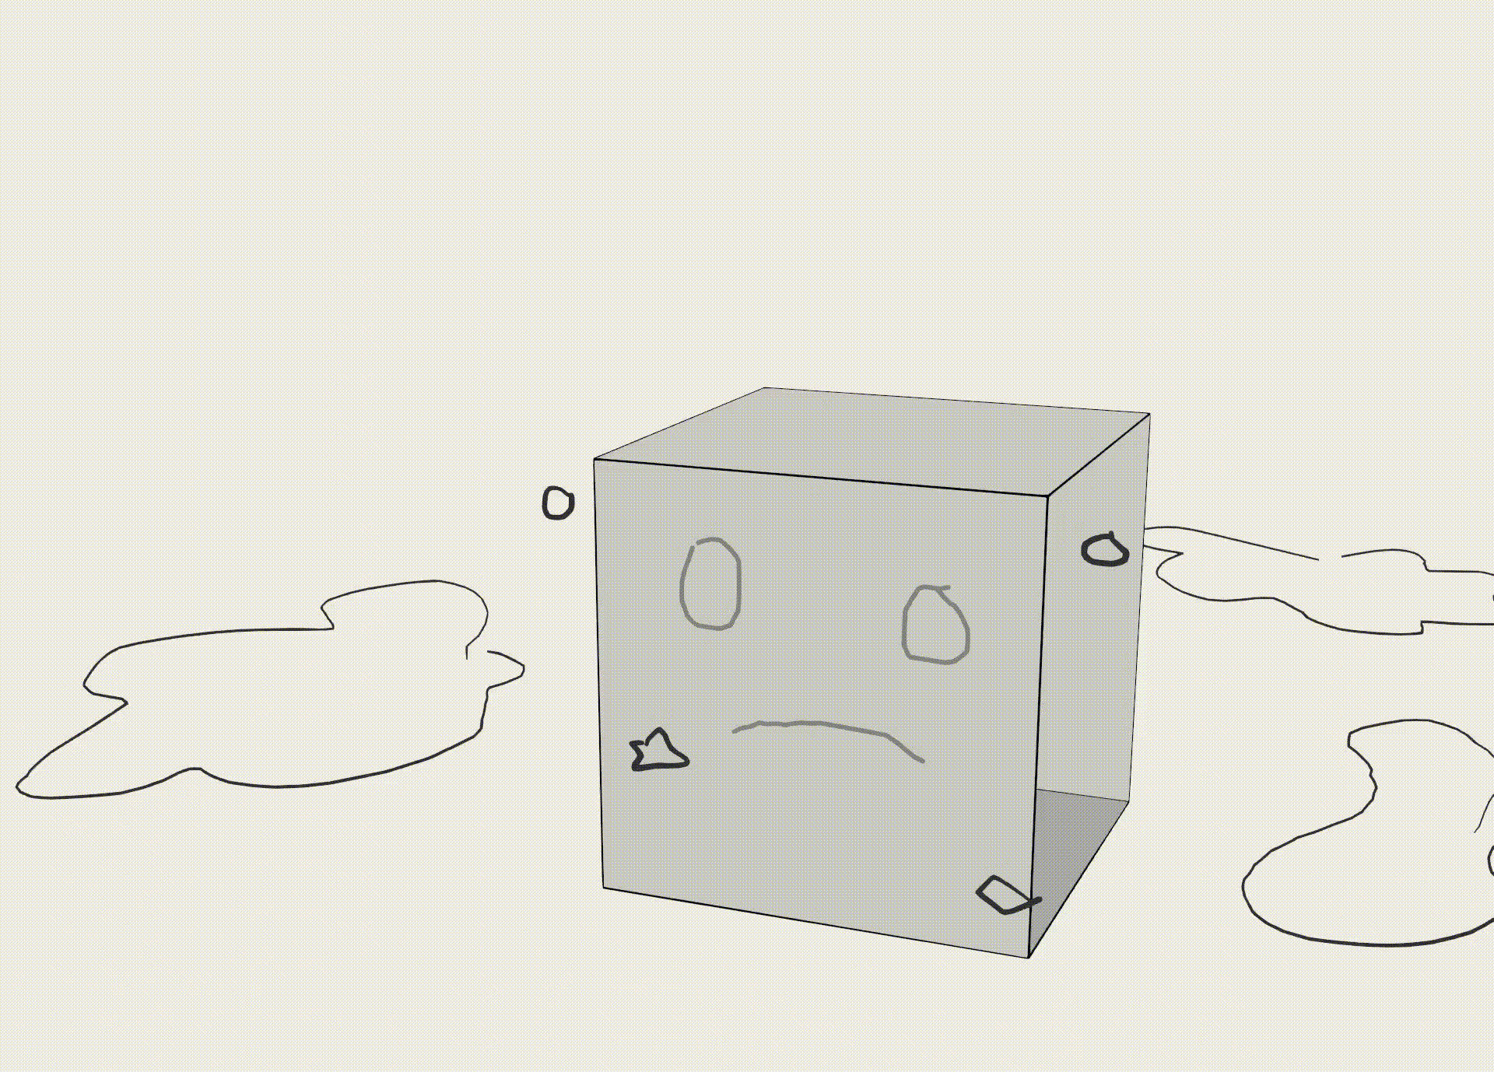
I want my work to be truly interdisciplinary
I’ve dipped my toes in the pool of interdisciplinary work, and I want to push this experimentation as far as I can.
I want to take part in fighting back against the narrative of art or technology, building the narrative of art and technology.
It would be amazing if visuals such as illustrations and animations started appearing in technical reports and whitepapers.
Notes:
Career goals
Where are you and your work now?
If you’re pivoting into a new industry, style, workflow, etc., explain
Intended audience
Ideal clients and why
How Adobe fits into your journey from where you are to where you’re headed

Slide 40
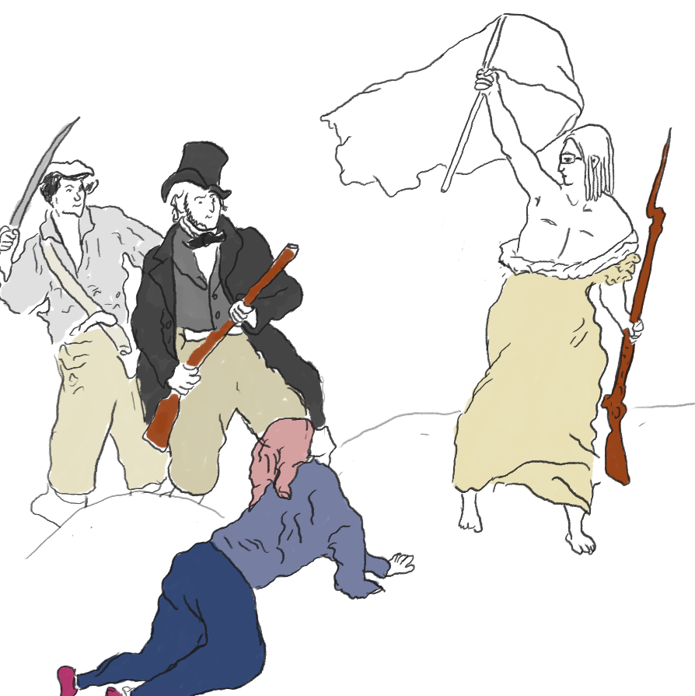
2) In order to do that, I want to be fully independent
While the Guardian was a dream job in some ways, it had its limitations, and I often felt like I had to compromise my creative vision.
I want to become independent so in the future, I am able to tell my full truth and dictate how my content is created. Nicky Case, Mona Chalabi. Pudding.cool
Because of my desire for full independence and creativity, my intended audience would be the general public!
I want to market to those that really resonate with my vision and start to build a community around visual thinking.
Notes:
Career goals
Where are you and your work now?
If you’re pivoting into a new industry, style, workflow, etc., explain
Intended audience
Ideal clients and why
How Adobe fits into your journey from where you are to where you’re headed

Slide 41
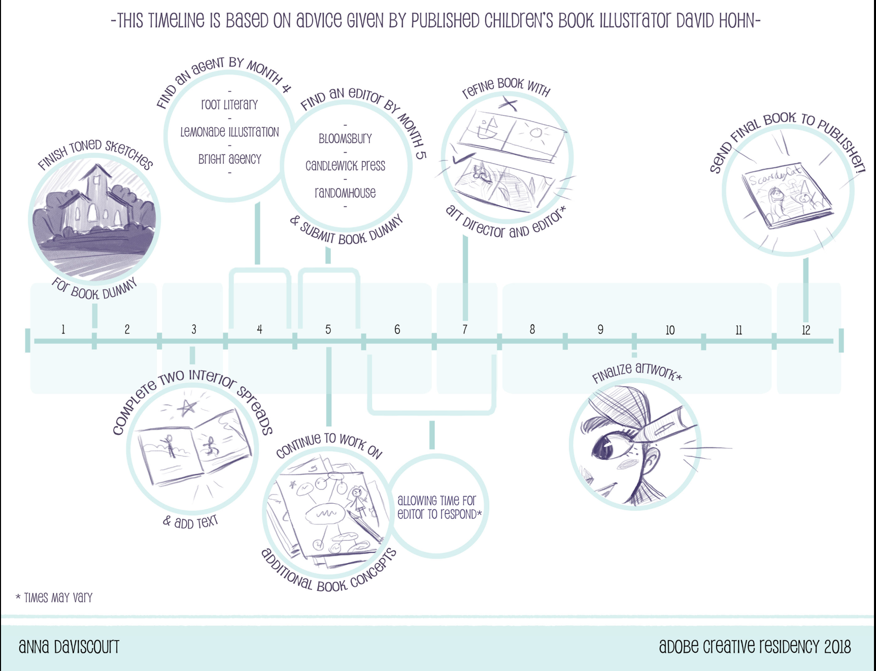
Project concept
When?
Visual timeline(s) of project(s)
Example: Anna Daviscourt’s timeline →
Extra credit: This included some research she had done on how long it might take her to do some parts of it. It doesn’t need to be 100% accurate, but should reflect that you’ve thought the timing through.

Slide 42
Where do I want to be?
Professionally, my background is kinda all over the place. It starts with University of Georgia, where I studied Computer Science
Professionally, my background is kinda all over the place. It starts with University of Georgia, where I studied Computer Science
I helped start a satellite lab, and we just sent our first into space in 2020.
I helped start a satellite lab, and we just sent our first into space in 2020.

Slide 43
Other people who’ve been able to achieve my dream
Nicky Case
Mona Chalabi
The company Brilliant
News publications like this and this and this that are incorporating visual/comic journalism
Dear Data
XKCD
Pablo Stanley’s The Design Team
Homestuck
Notes:
Career goals
Where are you and your work now?
If you’re pivoting into a new industry, style, workflow, etc., explain
Intended audience
Ideal clients and why
How Adobe fits into your journey from where you are to where you’re headed

Slide 44
Proposal for monthly community engagement
Outline impact and reach:
How will you share your project and process with the creative community?
What will others learn from your project?
What will you post on which channel and why? For example: blog on your website because you want your clients to be aware of your thought leadership and creative philosophy, tutorials on YouTube, process posts on Instagram.
Social sharing timeline: (should be as fleshed out as and complementary to your project timeline)

Slide 45

Professionally, my background is kinda all over the place. It starts with University of Georgia, where I studied Computer Science. I was heavy into STEM, joining a research lab and starting a satellite lab. I left college with a passion for science, technology.
2016
Odd Jobs Era
2017
A few UX design and software engineering gigs that battered me down. We don’t talk about this time *shudder*.
2018 - 2020
Finally, I landed at the Guardian newsroom. My favorite job by far, it was a place where I could use my different skills and passions to tell stories, stories about what was going on in the world, stories like COVID and the 2020 election. I’ve since left the job, but my passion for using visuals and interaction to explain ideas has never left me.
Notes:
Visual outline of your creative history: where you’ve been, where you are, where you’re headed
Brief and succinct explanation of your creative path to this point, or other helpful context for your project or creative journey.
2-3 examples of your past work that indicates your ability to complete this project

Slide 46
Episode I (2016)
Professionally, my background is kinda all over the place. It starts with University of Georgia, where I studied Computer Science.
Some would call me ‘booksmart’. I was a part of two research labs, and helped start a third one (I got to work with NASA on that one). I’m obsessed with everything STEM-related, and I left college with a love of learning.
The College Years
Episode II (2017)
Professionally, I was aimless, taking countless UX design gigs to survive. It took me two years, but I understood the type of work I did not want to do.
The Odd Job era
We don’t talk much about this time period *shudders*
That narrator is kinda rude.
Episode III (2018 - 2020)
Eventually, I stumbled into a job at the Guardian, and I fell in love. It was the only job where my love of tech and art and storytelling worked well together. But, as time went on, I noticed something.
My code and designs would take center stage for explaining stories like COVID and the election. That fact convinced me that there are some stories that need visuals and interaction in order to be told correctly.
The Guardian
That narrator is kinda rude.
Notes:
Visual outline of your creative history: where you’ve been, where you are, where you’re headed
Brief and succinct explanation of your creative path to this point, or other helpful context for your project or creative journey.
2-3 examples of your past work that indicates your ability to complete this project

Slide 47
Where do I want to be?
I want to create stories full-time. Most of my work so far has been in journalism, but I want my future work to involve narratives and characters, and I want them to live in tv shows, blogs, comic strips, books, theme parks, and more.
I want to continue to be interdisciplinary. More and more companies are looking for specialization, so I want to connect with the interdisciplinary community and network in that space.

Slide 48
Proposal for monthly community engagement
Designers are naturally curious, and I think many will jump at the opportunity to get better with technology.
To share my progress, I will work on a diary. This will be a plot.
What will others learn from your project?
Other designers will learn how to better use their art with technology. How to make animations, how to tell stories, how to merge technology
What will you post on which channel and why? For example: blog on your website because you want your clients to be aware of your thought leadership and creative philosophy, tutorials on YouTube, process posts on Instagram.
Social sharing timeline: (should be as fleshed out as and complementary to your project timeline)

Slide 49
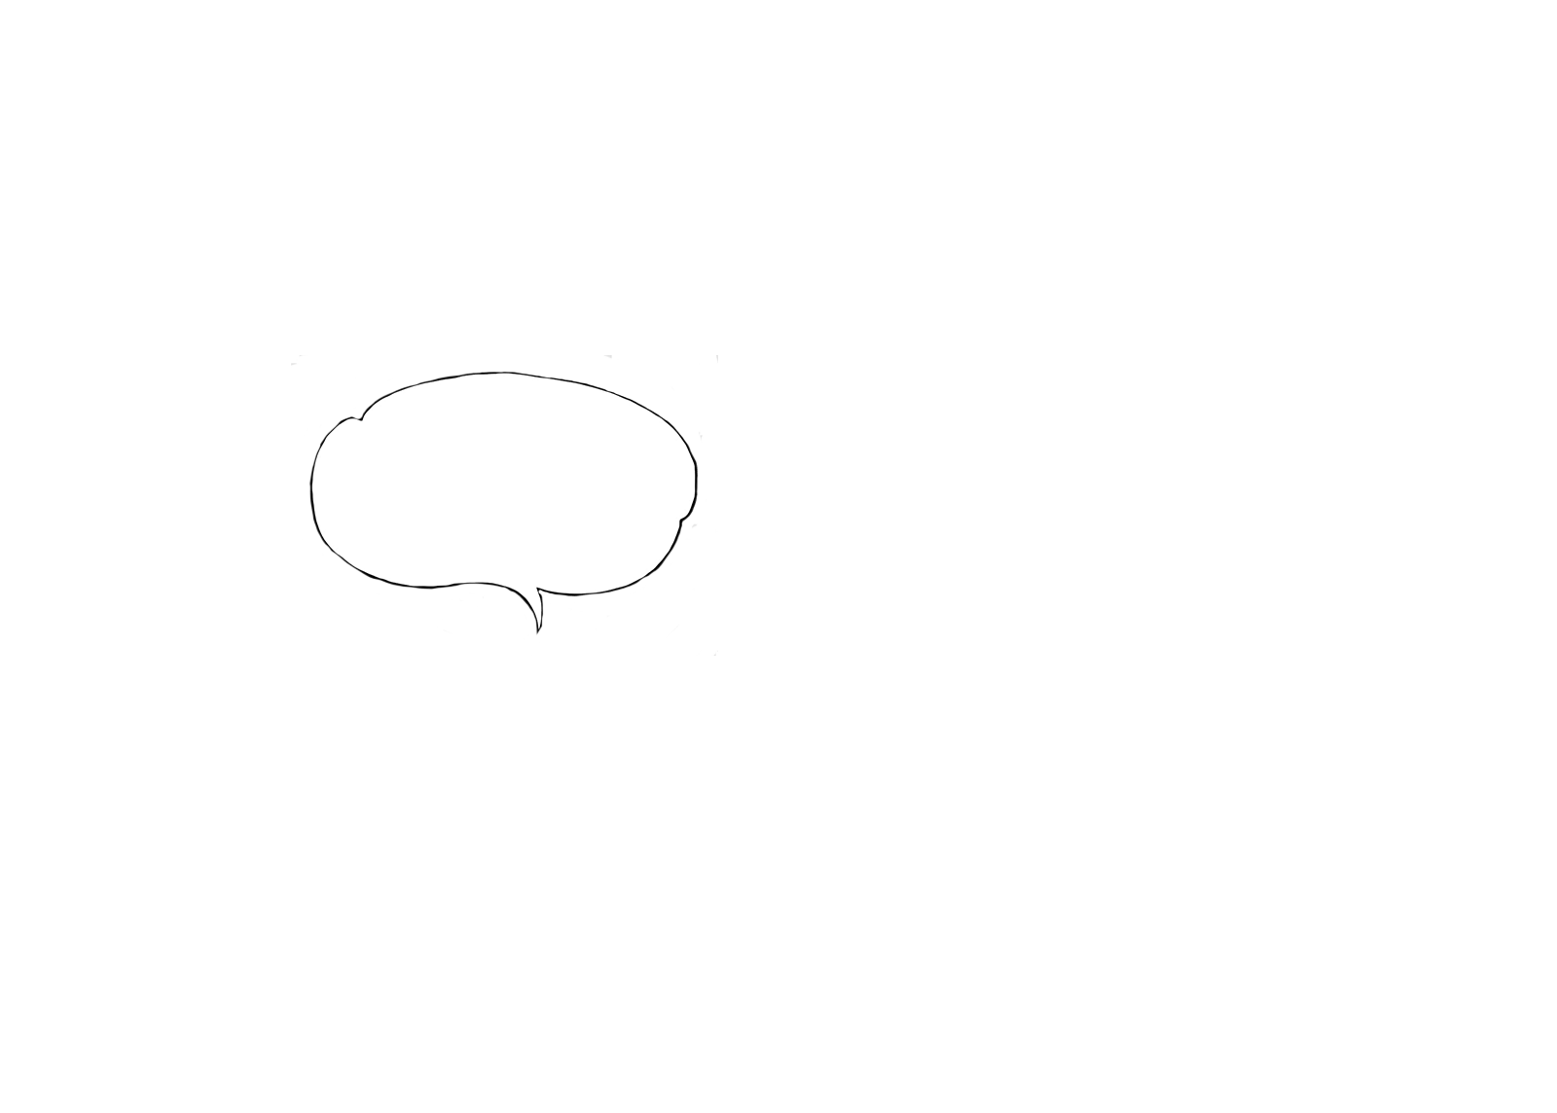
Today, we take a look at our hero, Juweek, and his Adobe application. Will he get it? I don’t think so! But let’s see.
The only place that needed a mix of skills like these was journalism, where anything was allowed as long as it helped explain something.
Let’s give this a shot.
I’m 26, and I live in Brooklyn, NY.
Hi. I’m the hero.
That narrator is kinda rude.
So, I got a job at the Guardian and I fell in love. It was really the only job where my weird skills worked well together, and I loved digging into
I’m a creative coder. It’s hard to explain, but just know that I know how to code websites.
different topics every week.
I also draw and design. When combined with code, I can make unique websites and animations.
I’ve since left the Guardian, but I still have my passion for educational storytelling..
Notes:
Introduction
3-5 sentences about you, including name, location, creative field, defining attributes, 1-2 of your relevant hobbies / passions

Slide 50
Today, we take a look at our hero, Juweek, and his Adobe application. Will he get it? I don’t think so! But let’s see.
Juweek codes and draws
My name is Juweek, and I live in Brooklyn. I’m 26, Haitian-American, and really into comic books. Professionally, I’m a journalist...kinda.
Hi. I’m the hero.
Juweek lives in NYC
I draw and code things that explain ideas to people rather than write. Most of my art involves websites, diagrams, and animations.
Juweek is a journalist.
Notes:
Introduction
3-5 sentences about you, including name, location, creative field, defining attributes, 1-2 of your relevant hobbies / passions

Slide 51
Today, we take a look at our hero, Juweek, and his Adobe application. Will he get it? I don’t think so! But let’s see.
Hi. I’m the hero.
The narrator’s kinda a jerk.
Let’s give this a shot.
I’m 26, and I live in Brooklyn, NY.
I also draw and design. When combined with code, I can make unique websites and animations.
That narrator is kinda rude.
I’m a creative coder. It’s hard to explain, but just know that I know how to code websites.
The only place that needed a mix of skills like these was journalism, where anything was allowed as long as it helped explain something.
So, I got a job at the Guardian and I fell in love. It was really the only job where my weird skills worked well together, and I loved digging into
different topics every week.
Notes:
Introduction
3-5 sentences about you, including name, location, creative field, defining attributes, 1-2 of your relevant hobbies / passions

Slide 52
Today, we take a look at our hero, Juweek, and his Adobe application.
Will he get it? I don’t think so, but let’s see.
The Artist statement
Juweek works to process technical information and channel it into visual and interactive stories, often adding humor to humanize the content and make it more accessible to companies and readers alike.
At the core of his essence, Juweek is an educator, and he cares a lot about making information more understandable to all.
Notes:
Artist statement
3 sentences about who you are as an artist, your value to your future clients, and what drives your creative vision.

Slide 53
I want to create stories full-time. Most of my work so far has been in journalism, but I want my future work to involve narratives and characters, and I want them to live in tv shows, blogs, comic strips, books, theme parks, and more.
Hi. I’m the hero.
I also draw and design. When combined with code, I can make unique websites and animations.
I want to continue to be interdisciplinary. More and more companies are looking for specialization, so I want to connect with the interdisciplinary community and network in that space.
More and more companies are looking for specialization, so I want to connect with the interdisciplinary community and network in that space.
Notes:
Introduction
3-5 sentences about you, including name, location, creative field, defining attributes, 1-2 of your relevant hobbies / passions

Slide 54
Artist statement:
Juweek works to process technical information and channel it into visual and interactive stories, often adding humor to humanize the content and make it more accessible to companies and readers alike.
At the core of his essence, Juweek is an educator, and he cares a lot about making information more understandable to all.
Notes:
Artist statement
3 sentences about who you are as an artist, your value to your future clients, and what drives your creative vision.

Slide 55
Today, we take a look at our hero, Juweek, and his Adobe application.
Will he get it? I don’t think so, but let’s see.
....uh, thanks..
Hi, I’m Juweek. I’m the hero.
The Introduction
I’m 26, and I live in Brooklyn, NY. I’m the son of two Haitian immigrants, a fan of basketball and history, and a huge comic book nerd.
Since a kid, I’ve loved comics, and I’ve always been a sucker for a good story. Even today, I like to draw and animate my own stories.
The Personality
Professionally, I’m a “creative coder”. It’s hard to explain, but basically I know how to make websites, and they generally veer on the more artistic side.
Most companies don’t really have need for “creative coders” since we’re pretty much artists.
However, there was one place where my skills were a perfect fit, a place where multidisciplinary work was encouraged: journalism.
That narrator is kinda rude.
The Art
Notes:
Introduction
3-5 sentences about you, including name, location, creative field, defining attributes, 1-2 of your relevant hobbies / passions

Slide 56
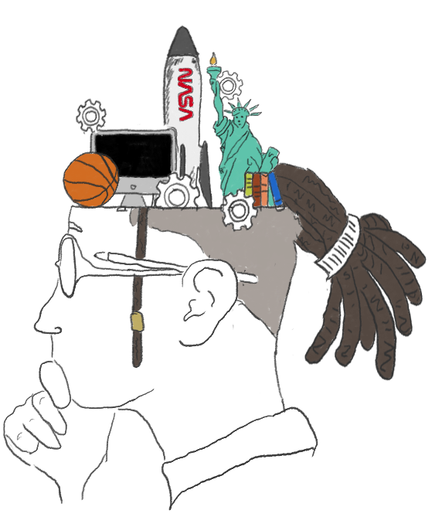
OK, let me try to explain to you what I do
A hero emerges.!
My name is Juweek Adolphe, and I’m a visual storyteller living in Brooklyn, NY.
What does it mean to be a visual storyteller? Well, I’m a journalist and I know how to do a lot of things, so I use that knowledge to make visual things (websites, diagrams, etc) that explain things to people.
Most of the time, the stories I tell are technical in nature, or what some people would call STEM (science, technology, engineering, math). I like to have a mindset more akin to STEAM, which is STEM but with an added A for art.
Notes:
Introduction
3-5 sentences about you, including name, location, creative field, defining attributes, 1-2 of your relevant hobbies / passions

